Slide 1
Classical IPC problems in OS

Slide 2
Readers Writer Problem
There is a shared resource which should be accessed by multiple processes.
There are two types of processes in this context. They are reader and writer.
Any number of readers can read from the shared resource simultaneously, but only one writer can write to the shared resource.
When a writer is writing data to the resource, no other process can access the resource.
A writer cannot write to the resource if there are non zero number of readers accessing the resource.

Slide 3
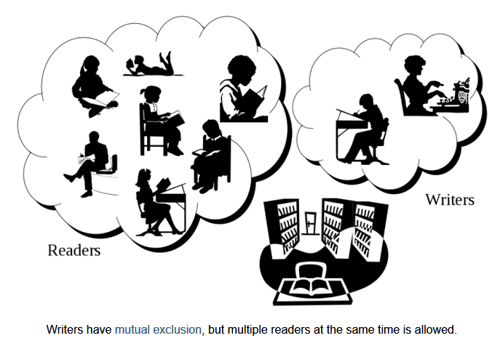

Slide 4
Readers Writer Problem
Reader() {
while(TRUE) {
down(mutex); //acquire lock
read_count++;
if(read_count == 1)
down (db);
up(mutex); //release lock
Read_DB();
down(mutex); // acquire lock
read_count--;
if(read_count == 0)
up(db);
up(mutex); // release lock
}
}

Slide 5
Readers Writer Problem
Writer()
{
while(TRUE) {
PrepareData();
down(db);
WriteData();
up(db);
}
}

Slide 6
What is the purpose of this code ?
Writer (i)
{
while(TRUE) {
PrepareData(i);
down(writermutex);
writer_Count++
if(writer_Count ==1)
down (db)
up (writermutex);
down(Exclusivelock)
WriteData(i);
up(Exclusivelock)
down(writermutex);
writer_Count--
up(writermutex);
if(writer_Count ==0)
up(db)
}
}

Slide 7
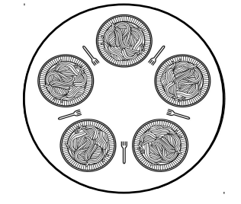
Dining Philosophers Problem
The is useful for modeling processes that are competing for exclusive access to a limited number of resources, such as I/O devices.
There are N philosophers sitting around a circular table eating spaghetti and discussing philosophy.
The problem is that each philosopher needs 2 forks to eat, and there are only N forks, one between each 2 philosophers.
Design an algorithm that the philosophers can follow that insures that none starves as long as each philosopher eventually stops eating, and such that the maximum number of philosophers can eat at once.
• Philosophers eat/think
• Eating needs 2 forks
• Pick one fork at a time

Slide 8
Dining Philosophers Problem
The problem was designed to illustrate the problem of avoiding deadlock, a system state in which no progress is possible. One idea is to instruct each philosopher to behave as follows:
think until the left fork is available;
when it is, pick it up
think until the right fork is available; when it is, pick it up
• eat
• put the left fork down
• put the right fork down
• repeat from the start

Slide 9
Dining Philosophers Problem
>>This solution is incorrect: it allows the system to reach deadlock. Suppose that all five philosophers take their left forks simultaneously. None will be able to take their right forks
philosopher(i)
{
while (true)
{
think();
take_fork(i); //left fork
take_fork((i+1)%5); //right fork
eat () ;
put_fork(i);
put_fork ((i+1)%5);
}
}
>> If right fork cant be acquired, leave the left fork and try again
> Still deadlocked
>> If right fork cant be acquired, leave the left fork, wait for a random time and then try to pick the forks again
> Solution may work and may fail in some undesired situation

Slide 10
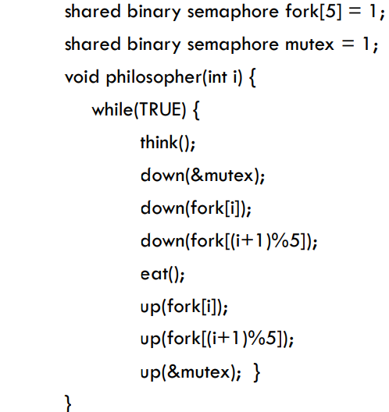
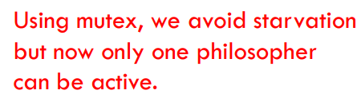
Better solution ?
TakeFork
TakeFork
With five forks available, we should be able to allow two philosophers to eat at the same time.
PutFork
PutFork

Slide 11
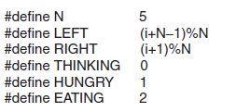

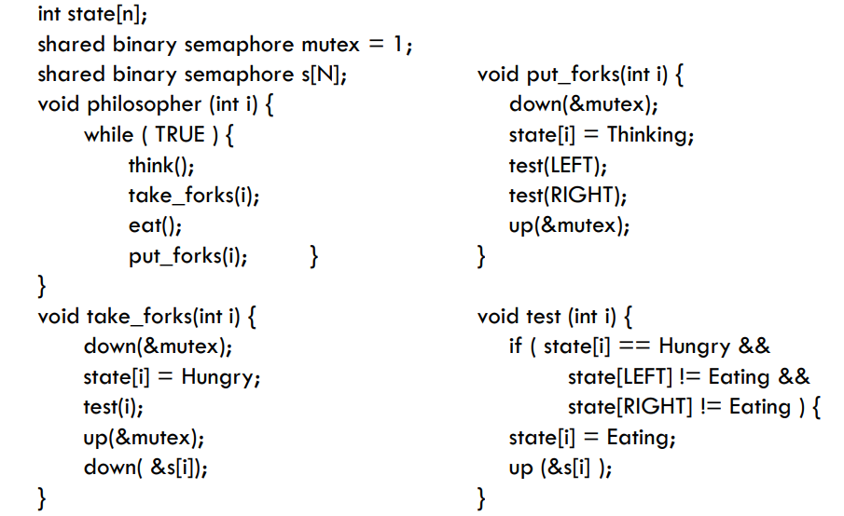
Better solution ?

Slide 12
Dining Philosophers Problem
This solution presented is deadlock-free and allows the maximum parallelism for an arbitrary number of philosophers.
It uses an array, state, to keep track of whether a philosopher is eating, thinking, or hungry (trying to acquire forks).
A philosopher may only move into eating state if neither neighbor is eating.
Philosopher i's neighbors are defined by the macros LEFT and RIGHT. In other words, if i is 2, LEFT and RIGHT represent 1 and 3, respectively
The program uses an array of semaphores, one per philosopher, so hungry philosophers can block if the needed forks are busy

Slide 13
The Sleeping Barber Problem
The barber shop has one barber, one barber chair, and n chairs for waiting customers, if any, to sit on.
If there are no customers present, the barber sits down in the barber chair and falls asleep.
When a customer arrives, he has to wake up the sleeping barber. If additional customers arrive while the barber is cutting a customer's hair, they either sit down (if there are empty chairs) or leave the shop (if all chairs are full)
The problem is to program the barber and the customers without getting into race conditions.
Similar to various queueing situations, such as a multiperson helpdesk with a computerized call waiting system for holding a limited number of incoming calls.

Slide 14
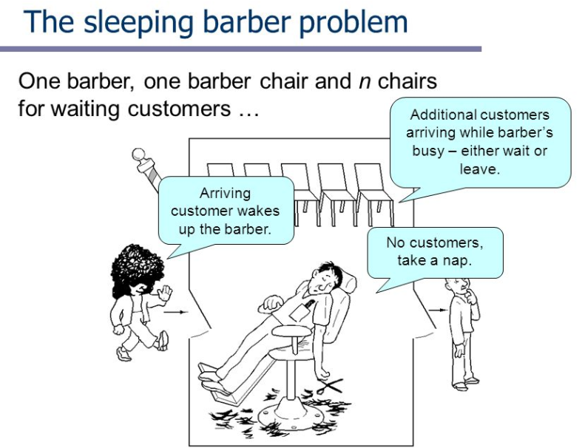
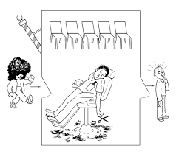

Slide 15
#define CHAIRS 5 /* # chairs for waiting customers */
typedef int semaphore; /* use your imagination */
semaphore customers = 0; /* # of customers waiting for service */
semaphore barbers = 0; /* # of barbers waiting for customers */
semaphore mutex = 1; /* for mutual exclusion */
int waiting = 0; /* customer are waiting (not being cut) */
void barber(void)
{
while (TRUE) {
down(&customers); /* go to sleep if # of customers is 0 */
down(&mutex); /* acquire access to "waiting' */
waiting = waiting - 1; /* decrement count of waiting customers */
up(&barbers); /* one barber is now ready to cut hair */
up(&mutex); /* release 'waiting' */
cut_hair(); /* cut hair (outside critical region */
}
}
void customer(void)
{
down(&mutex); /* enter critical region */
if (waiting < CHAIRS) { /* if there are no free chairs, leave */
waiting = waiting + 1; /* increment count of waiting customers */
up(&customers); /* wake up barber if necessary */
up(&mutex); /* release access to 'waiting' */
down(&barbers); /* go to sleep if # of free barbers is 0 */
get_haircut(); /* be seated and be served */
}
else {
up(&mutex); /* shop is full; do not wait */
}
}

